Slide 1
Discrete Structures
Instructor: Zubaria Asma
Course Code: CS-335
Credit Hours: 3(3-0)
Lecture # 20

Slide 2
Series

Slide 3
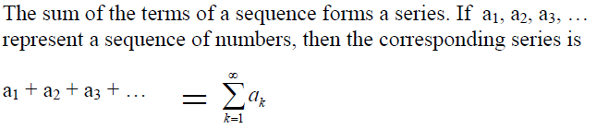
SERIES:

Slide 4
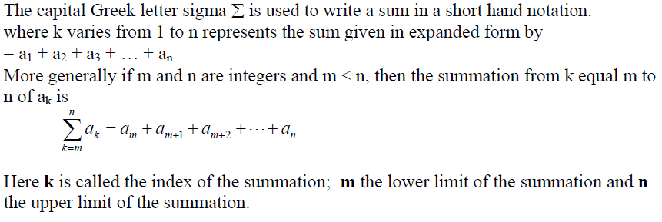
SUMMATION NOTATION:

Slide 5
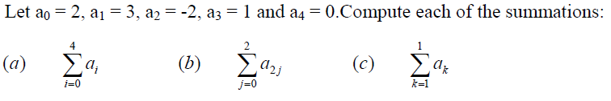
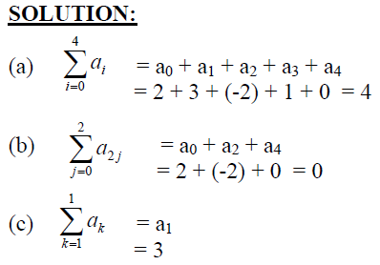
COMPUTING SUMMATIONS:

Slide 6

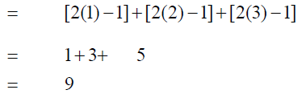

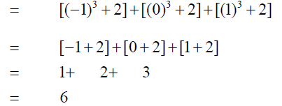
COMPUTING SUMMATIONS:

Slide 7

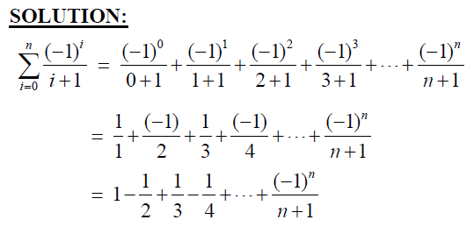
SUMMATION NOTATION TO EXPANDED FORM:

Slide 8
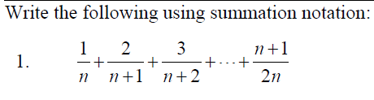
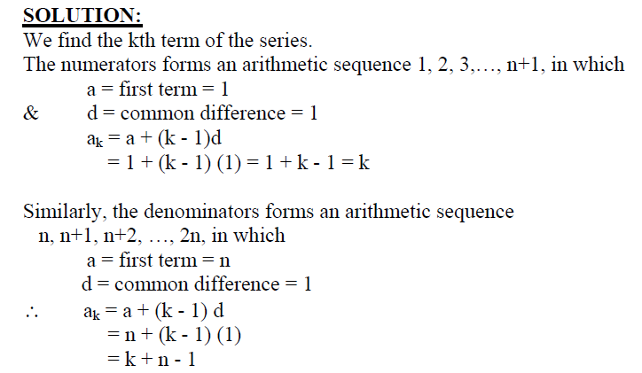
EXPANDED FORM TO SUMMATION NOTATION:

Slide 9
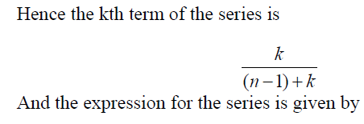
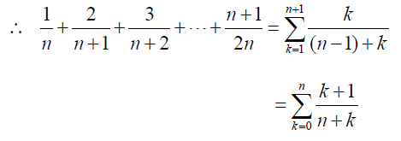
EXPANDED FORM TO SUMMATION NOTATION:

Slide 10
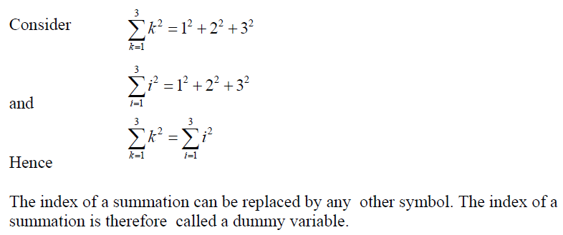
TRANSFORMING A SUM BY A CHANGE OF VARIABLE:

Slide 11
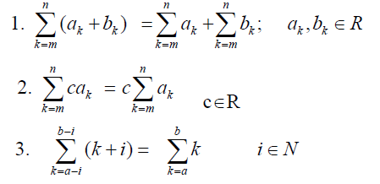
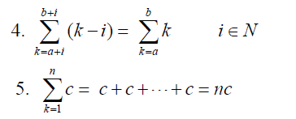
PROPERTIES OF SUMMATIONS:

Slide 12


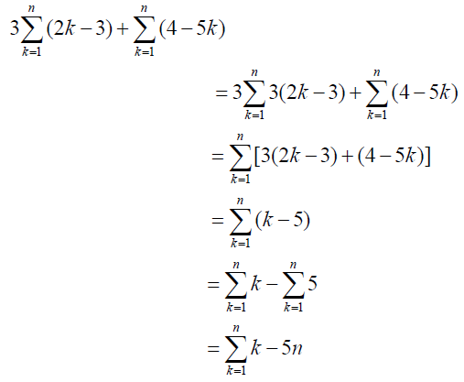

Slide 13
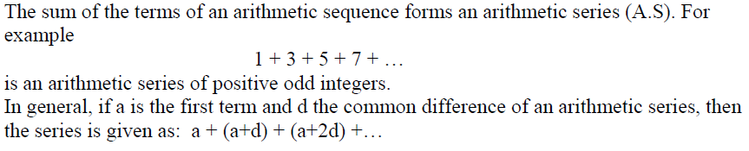
ARITHMETIC SERIES:

Slide 14
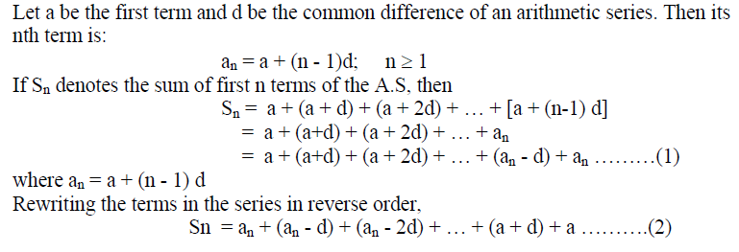
SUM OF n TERMS OF AN ARITHMETIC SERIES:

Slide 15
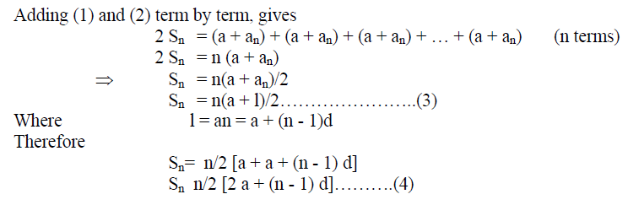
SUM OF n TERMS OF AN ARITHMETIC SERIES:

Slide 16
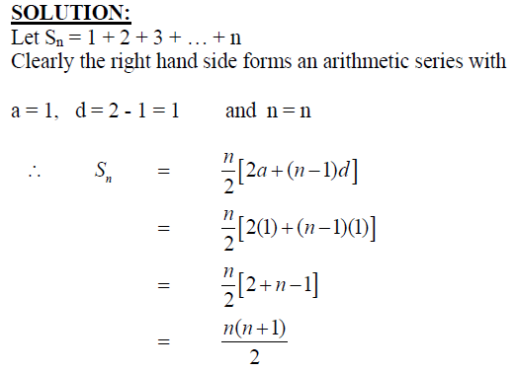
EXERCISE:

Slide 17
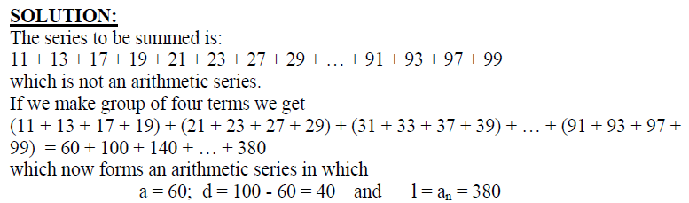
EXERCISE:

Slide 18
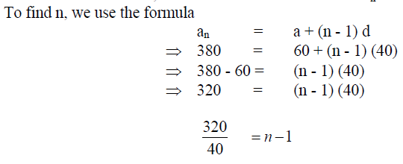
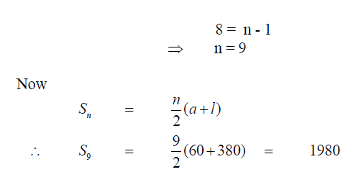

Slide 19
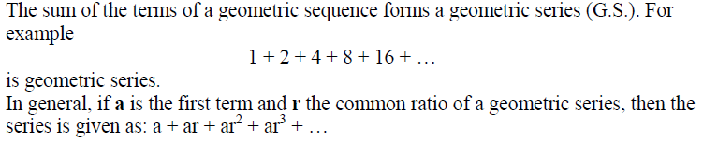
GEOMETRIC SERIES:

Slide 20
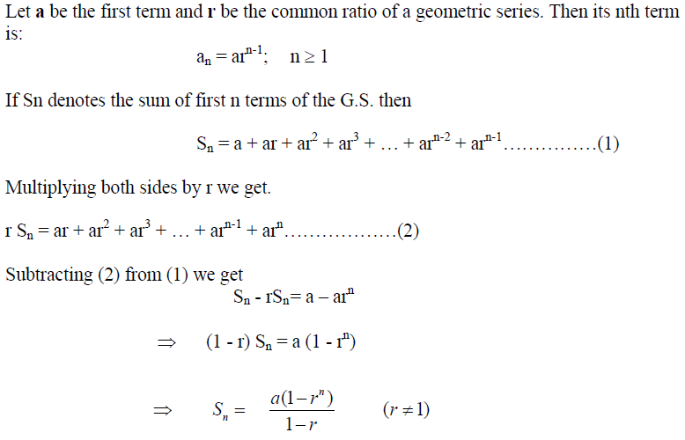
SUM OF n TERMS OF A GEOMETRIC SERIES:

Slide 21

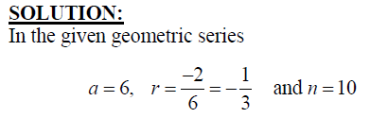
EXERCISE:

Slide 22
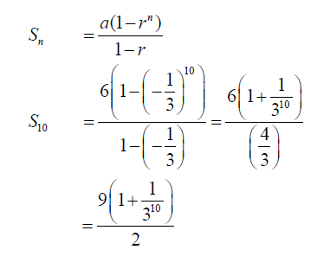

Slide 23
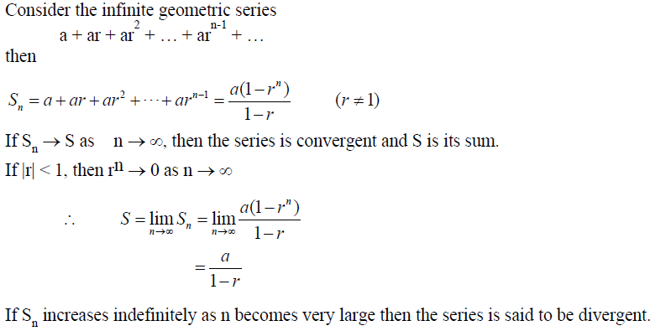
INFINITE GEOMETRIC SERIES:

Slide 24
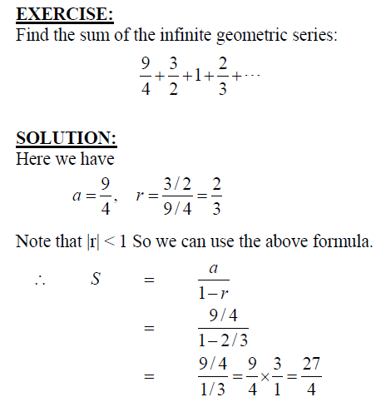

Slide 25
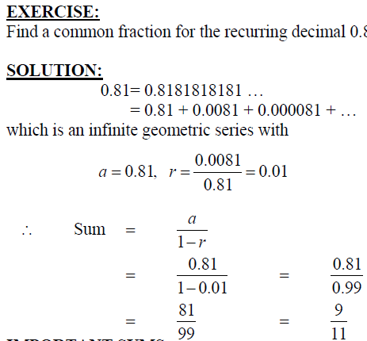

Slide 26
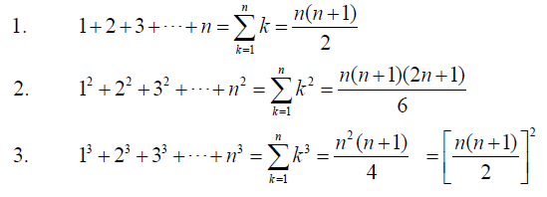
IMPORTANT SUMS:

Slide 27
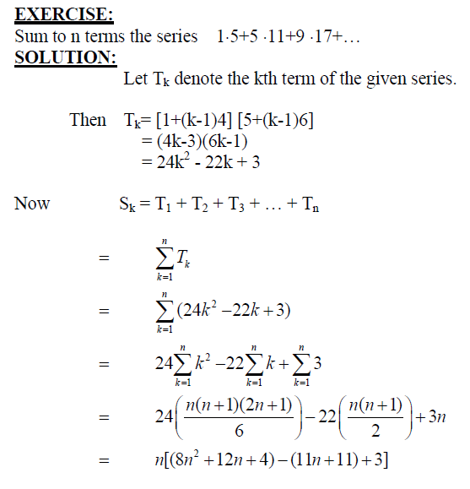

Slide 28

THANK YOU

